Slide 1
Cluedo Python Implementation
Christopher Chan
CS670 – Artificial Intelligence
Professor Kaur

Slide 2
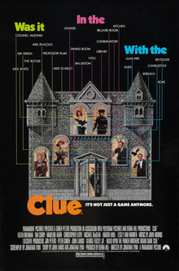
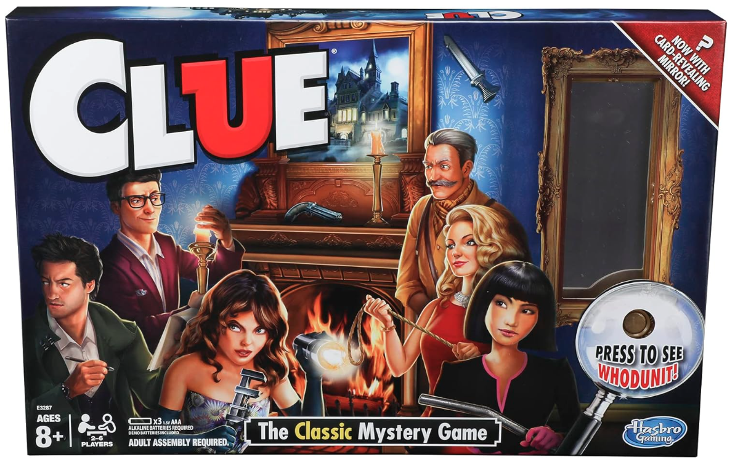
Cluedo History and Motivation
Designed by Anthony E. Pratt, Cluedo in 1949
Translated murder mystery parties during the 1930s
Combined elements of deduction and mystery
Inspired mystery films and game shows

Slide 3

Why Python?
Simple and intuitive
Large collection of libraries that can help with game development
Cross platform compatibility
Large community

Slide 4
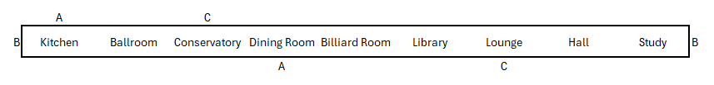
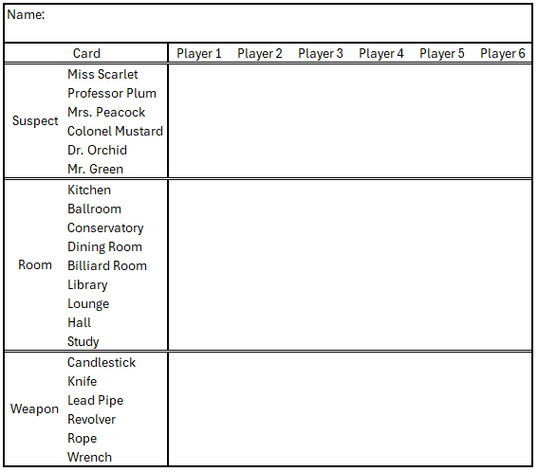
High Level Cluedo Implementation Overview
21 cards
6 suspects
6 weapons
9 rooms
Mansion layout in a linear map
Players are able to traverse left or right OR through tunnels denoted by symbols
Upon suggestions, the player can make notes of the shown cards to deduce the murder

Slide 5
Gamerule
A murder solution is randomly selected by picking a random murderer, weapon, and room
The remaining cards are shuffled and distributed
Turn based logic:
Player can move to an allowable room
Player can make either a suggestion, accusation, or no move
If suggestions, in a clockwise order, players will take turns until a player has a card from the suggestion
If accusation, accuser will look at the card in solution
If the cards match, the game is over
If the cards do not match, the player will no longer have a turn, but will continue to reveal cards in suggestion

Slide 6
Gameplay

Slide 7

Challenges
Handling edge cases
Removing players if accusation fails
Showing one card if a player has multiple cards in a suggestion claim
Map traversal
Dice-based movement
Implementation of bonus cards
Skip a turn, double suggestion, etc.

Slide 8

Next Steps
AI agents
Allow for singleplayer
Auto-deduction
Game card auto deduces possible combination and probability
Graphical User Interface
Enchance user experience beyond python terminal I/O
Web based application

Slide 9
Thank you!

